Slide 1

Learning knowledge graph-based world models of textual environments
Richa Patel
027972111
CECS 551
California State University Long Beach

Slide 2
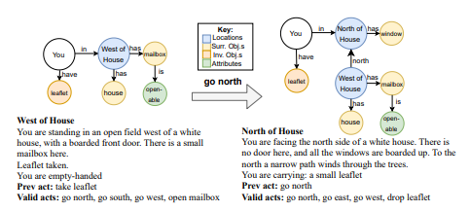
World models and text-based games
Improve agent’s ability to operate in interactive environments
Ability to predict changes in the world based on one’s actions will help to plan one’s future actions
Players perceive and interact with the world through textual natural language
Can be completed by interacting with many locations, characters and objects

Slide 3
Knowledge representation problem
Prior models used lifted representation – information extracted from surrounding while navigating novel environment (through rules, question-answer, transformer-based extraction)
Agents relying on lifted representation benefit from memorization but lack in the ability to predict changes in graph state representation.
Combinatorially-sized action space – contextually relevant actions are overwhelmed by irrelevant actions
Hypothesize 2 challenges – “what actions can I perform?” and “How will the world change if I perform a particular action?”

Slide 4
4 contributions
Show how changes in the world can be represented in the form of differences between subsequent knowledge graph state representation
Present Worldformer – multi-task transformer-based architecture that learns both the set of graph differences and the set of contextually relevant actions
Introduce loss function and training methodology for effective training of worldformer
Study conducted on never-before-seen text games to show significance of above contributions

Slide 5
Background
Jericho world dataset – 24198 mappings between rich natural language observations and: 1) knowledge graph in the form of tuples set (s - subject, r - relation, o - object). 2) natural language actions that cause changes in world state
Each instance of dataset (St, A, St+1, R) – St, St+1 are 2 states, A – action, R – reward
2 tasks: 1) knowledge graph generation. 2) valid action generation

Slide 6
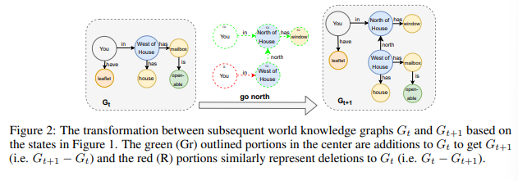
Knowledge graph generation
Instead of predicting Gt+1 given Gt and prior context, we predict difference between Gt and Gt+1
Observations:
Set of tuples added to Gt = Gt+1 – Gt . Set of tuples deleted from Gt = Gt – Gt+1
Locations are fixed & unique
Objects & characters can only be in 1 location at a time
Contradicting object attr – object cannot be open and closed simultaneously
Task – predict nodes to add to Gt at time step t to transform it into graph Gt+1 given textual observations, valid actions, graph at time t and actions A for all samples in the dataset

Slide 7
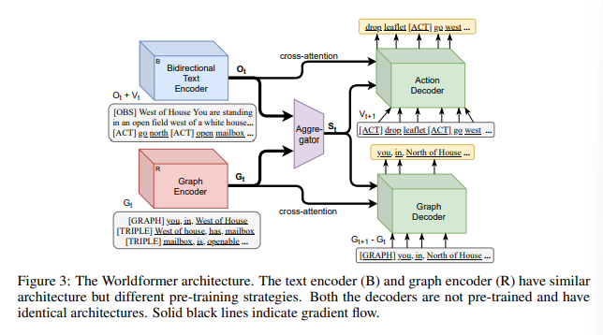
Worldformer – multi-task architecture
Input to worldformer – textual observations, valid actions, graph at time step t
Vt encoded to Ot, Gt encoded to Gt. Both passed to aggregator -> combined encoded state representation St
Action decoder conditioned on St directly and Ot through cross-attention and takes valid actions of next state Vt+1 as input
Graph decoder conditioned on St directly and Gt through cross-attention and takes knowledge graph of next state Gt+1 as input

Slide 8



Set of Sequences generation & training
Standard autoregressive decoding techniques factor the distribution over the target sequence into a chain of conditional probabilities. Θ represents overall network parameters
Maximum likelihood training loss with cross-entropy at every step:
In our setting, we can group elements in Y into its SOS form,

Slide 9
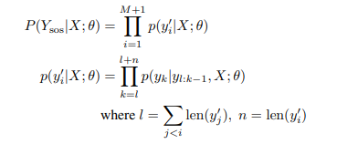
Set of Sequences generation & training
Factorizing distribution over output set of sequences as chain of probabilities:
Each element of Ysos is independent of other elements but tokens of each element yi’ is conditioned on preceding tokens within the element

Slide 10
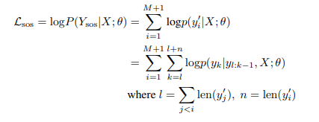
Maximum likelihood set of sequences loss
Maximum likelihood set of sequences loss used to train the model to output a set of sequences
Combined loss across both decoders:

Slide 11
Evaluation
Two metrics: exact match and F1 – operating at graph level and token level
Graph level: all 3 tokens in a triple (s, r, o) must match the ground truth triple to count as true positive
Token level: any relation or entities in predicted token must match the ground truth to count as true positive
Positive exact match or F1 happens only when all tokens in a predicted valid actions match one in the gold standard set
Worldformer performs better than other baselines on graph level.
Worldformer outperforms seq2seq model in valid action prediction

Slide 12
Conclusion
Presented worldformer: world model for text games
Three potential implications:
Simplification of knowledge representation problem into predicting knowledge graph differences between states
Performance improvement due to multi-task training
Performance improvement due to SOS loss instead of simple sequence loss

Slide 13
Thankyou

